Slide 1

Luckin Coffee Accounting Controversy
External Stakeholder Requirements
Group G

Slide 2
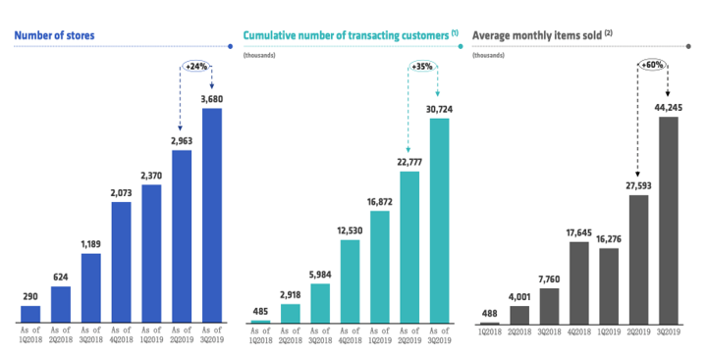
Luckin Coffee 2019 and 2020 annual report
Potential Risks in Early 2019
Aggressive growth strategy, nearly impossible to achieve the target.
The biggest shareholder kept losing money.
The founder members had failed IPO experience before.
Looking Backward to the 2019 Report
The total number of stores and transacting consumers both increased in a correlated ratio.
The number of items sold climbed by 70% in Q2 2019 and 60% in Q3 2019, even though the number of stores expanded by just about 24% in both quarters.

Slide 3
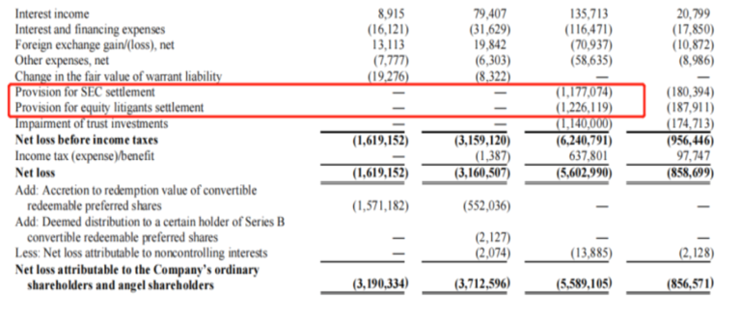
Luckin Coffee 2019 and 2020 annual report
Comparing 2019 and 2020 Annual Report
A significant loss of litigant settlements and SEC settlements in 2020.
The number of stores increased under pandemic.
The YOY revenue increased 33% in 2020.
Actions Taken to Rebuild Trust
A settlement was achieved with SEC to stop the investigation.
Reorganize the key positions and board members.
Restructure the equity with Luckin’s major creditors

Slide 4
Press Release
Main purpose of a press release:
To notify the media about an event in hopes that they will spread the word.
To share something about your business, hoping a reporter will see a story in your press release and write an actual news article about it.
To promote your business' appearance on the internet via blogs, websites, and social networks.
Reason:
Luckin Coffee wants to make investors aware of the major events related to the company as soon as possible, hoping to redeem as much as possible the mistakes made by the company and the large number of disappointed investors and to give confidence to the market.

Slide 5
Press Release
Actions has the company highlighted to address the issues:
The company established a special committee to conduct an internal investigation, and the special committee also hired independent legal counsel and forensic accountants. The company subsequently suspended the COO - Mr. Jian Liu, and those employees suspected of misconduct based on the results of the investigation.
Additional actions should management have taken:
Sine there was such a major problem, several other executives were more or less responsible, especially the CRO and the CEO. If the CRO and the CEO were aware, then they acquiesced to the data fraud; if they were not aware, then they were not competent and the company had huge loopholes that needed a series of improvements.
Do you think the accounting controversy could have been avoided?
We think this situation could certainly have been avoided. In fact, it is a rather outrageous situation. Generally speaking, there can be some degree of manipulation of statements, such as understate and overstate certain items, but outright fabrication of data to the extent that Luckin Coffee does is very rare.

Slide 6
Operational failure
Three lines of defense
Key Risks
1st LOD: Lies with the business, integrity and accuracy of data were comprised
2nd LOD: Lies with internal management, either accidentally or intentionally failed to test and challenge these fabricated financial and operating numbers.
3rd LOD: Lies with internal audit, no issues were raised by internal audit on practices followed in the firm, neither it could identify any of the accusations stated in the anonymous report.
Inadequate accounting and financial reporting procedures.
Lack of adequate controls, and policies to monitor accesses to data for financial reporting.
Operational human resources risk
Reputational Risk

Slide 7
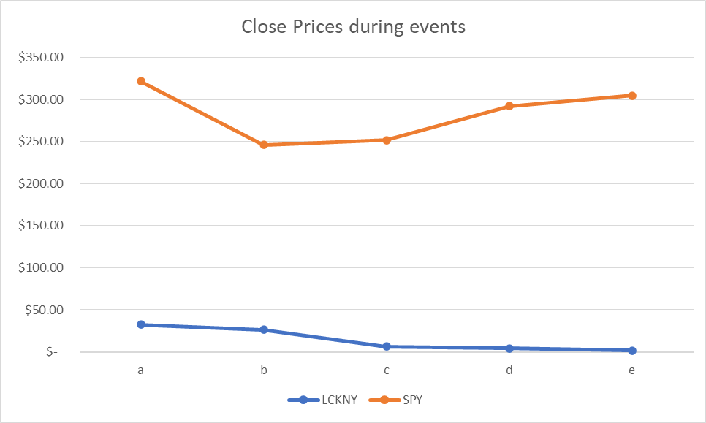
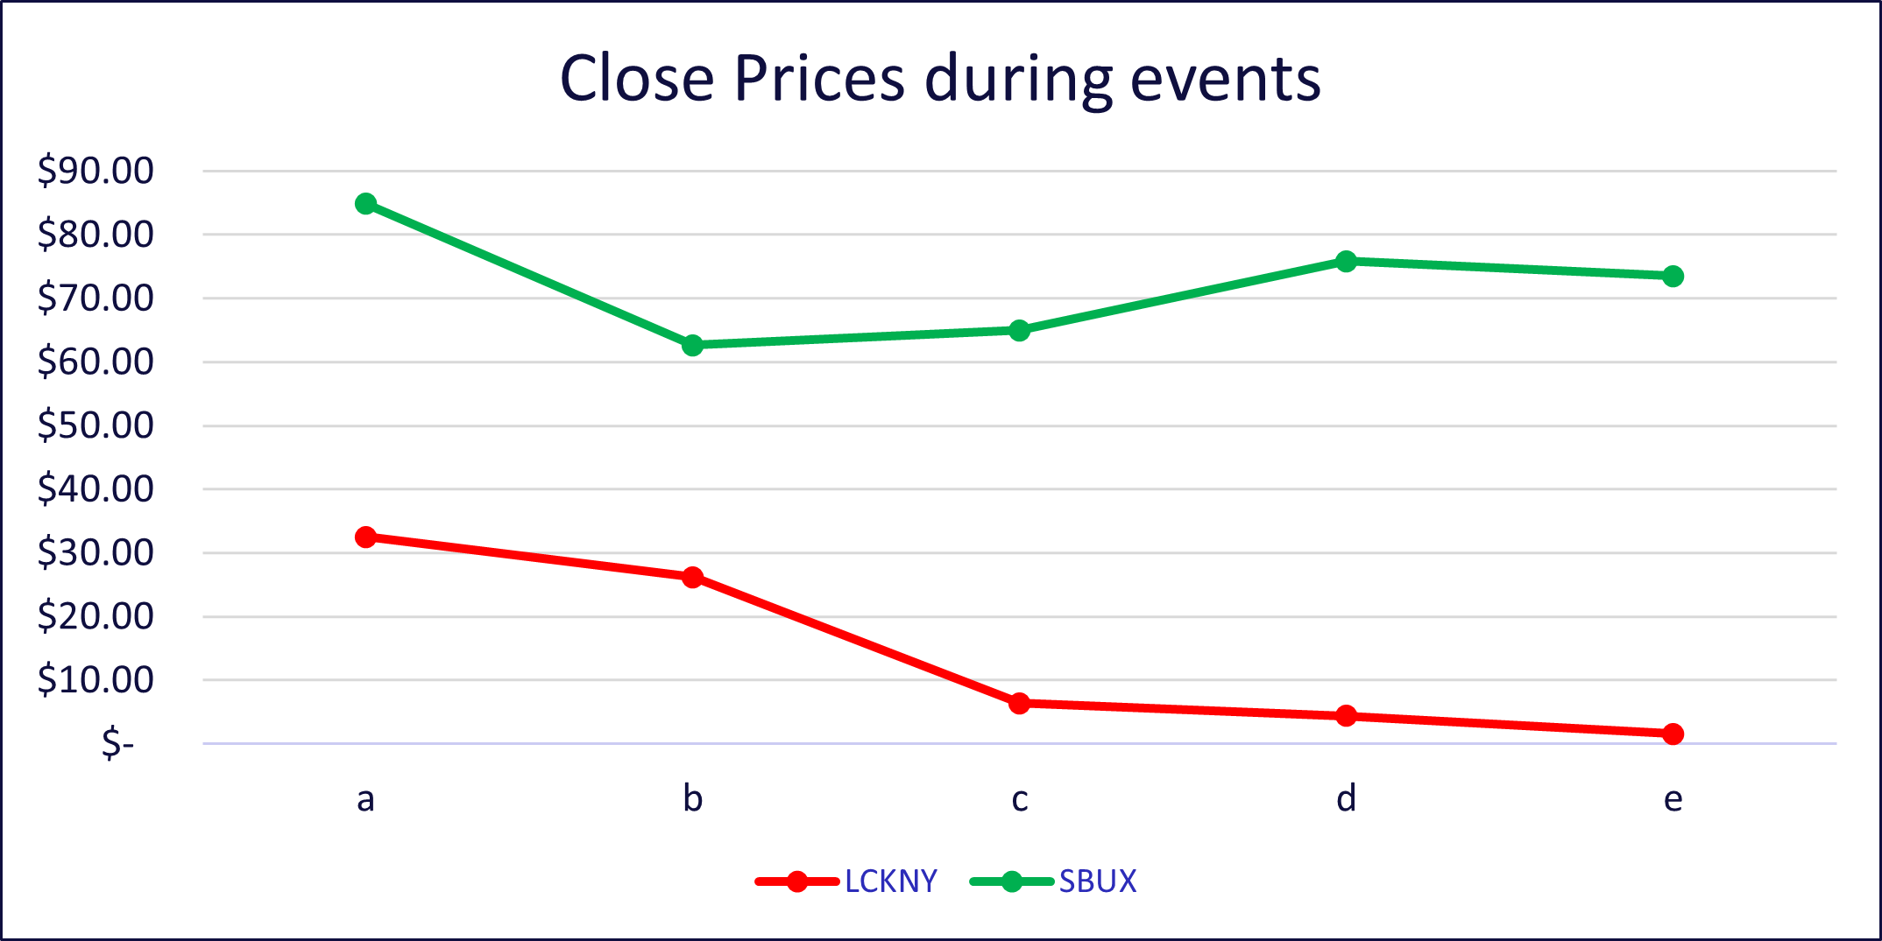
Stock Performance
Compared to U.S. Stock Market
Compared to competitor

Slide 8

Questions and Feedback
DONGYE LIU
<dl3386@columbia.edu>
TIAN WU
<tw2831@columbia.edu>
YOGESH ROHRA
<yar2115@columbia.edu>
ZHUOCHENG KONG
<zk2252@columbia.edu>

